Slide 1
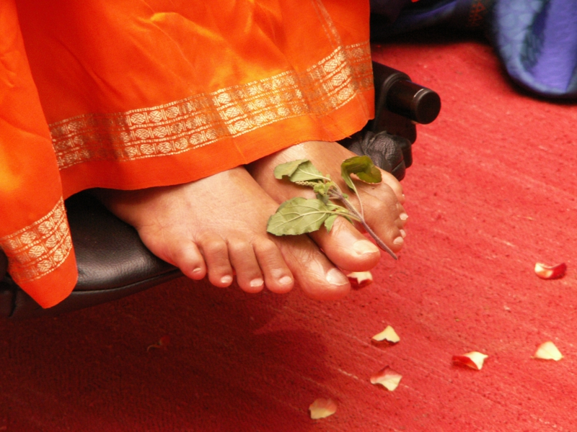
Offering my humble salutation to Bagawan sri sathya sai baba

Slide 2



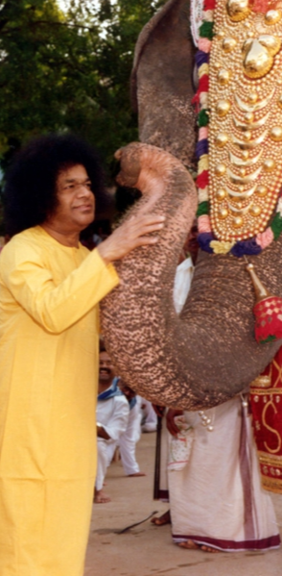

SATHYAM
SIVAM
SUNDARAM
Part - 1

Slide 3



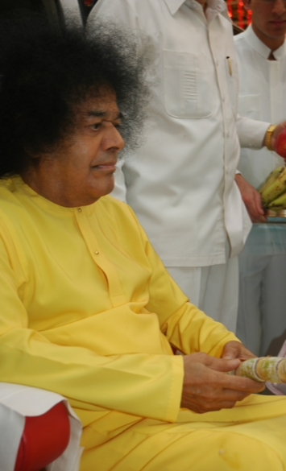
Chapter -15
Chapter name :- Lets’ Begun
The hospital Day celebration
The thousands who attented the Dasara celebration of 1960 must be even now remembering the thrilling declarations that baba made in his Discourses,About Himself and his mission.The very first day,during the hospital day celebrations, Bagawan said that it is waste of time,energy to force incomprehensively abstruse vedanthic doctrine down the throats of simple uncleared folk.

Slide 4
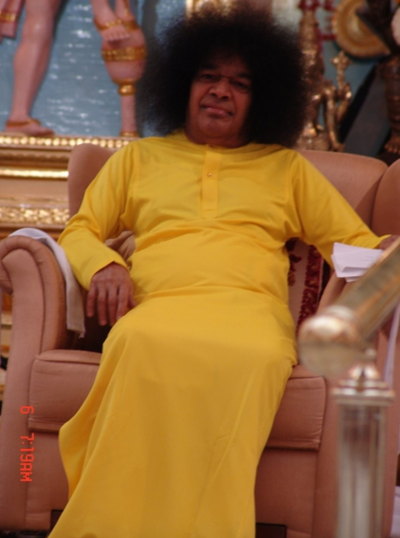
“Prema is the seed, Bakthi the sprout, Faith the manure, sathsanga the rain, Surrender the flower and merging with the lord the fruit he declared.”
Divine Speaks!

Slide 5


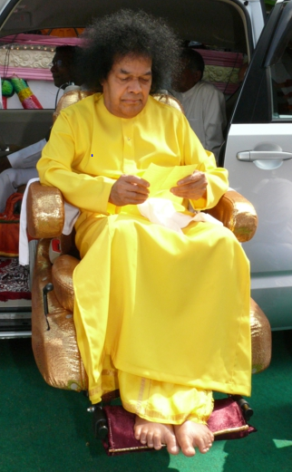
Can we understand items?
“Some ignorant people commenting on me say that I have a double personality daivathwam (divinity)most of time. But manushyathwam (Humanity) the rest of time ”.
But have faith in this, I am ever and always, of the “thwam” of the “ity” only. God does not change, or get transformed. I am telling you this because us, not the mere casual connection of visitor and visited”.

Slide 6
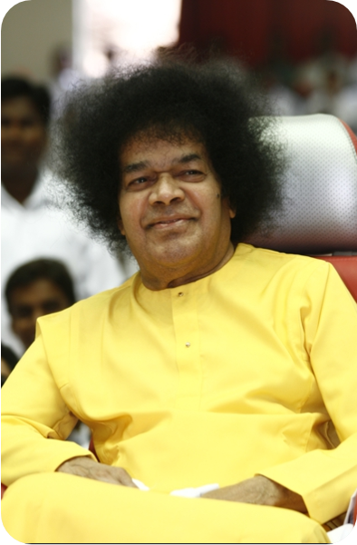
Mind them!!
On Guru Pournami day ,1961,at Mysore. “The time has come to weed out the gurus who are setting bad example to the sishyas (students), The sanyasis who complete in the accumulation of comforts and the acquisition of frame. ”
On Mhasivarathri day, There is no one in this world who does not belong to me; all are mine; they may not call out my name or any name; but, they are mine.
For this function is the beginning of a new era. The sathya sai Era, force of all.

Slide 7
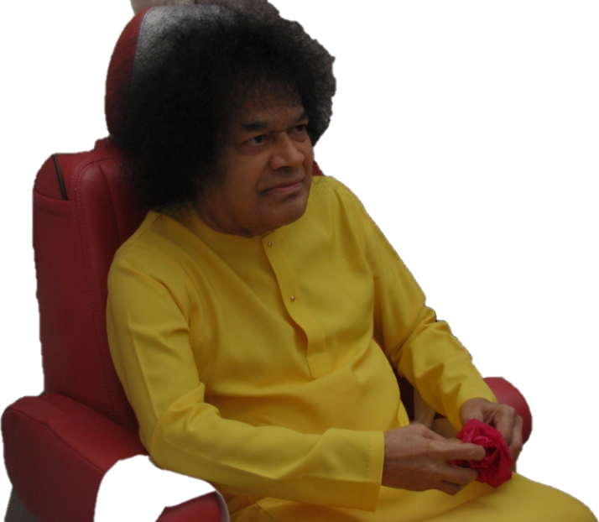
Baba has often said that the holiness of a place of pilgrimage is proportionate to the devotion, Which the bhaktas bring with them and the sincerity of the prayer, which they pour forth before the shrine.
Baba planned a tour of Ayodhya and Benares after a short stay at Madras. On 23rd march. baba addressed a mammoth gathering at railway stadium,Perambur and the silent admiration,which the assembly evinced throughout the address made Dr. Ramakrishna Rao (The governor of Uttar Pradesh).

Slide 8
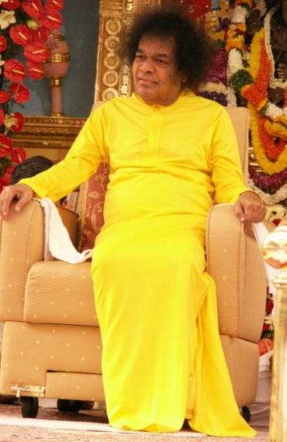
Dr. Ramakrishna Rao
Dr . Ramakrishna Rao invited Baba to lucknow and when he was there, He allowed the citizens of lucknow to attend the bajans sessions at the Raj Bhavan. Some of them were aware of his presence and by seeing miraculous happening, Which attracted more seekers to him.
He also addressed a meeting at the Town hall, Under the auspices of the Andhra Association, the Tamil sangha,The Kerala Association and the Mysore Association, who felt that they should honour him. Presumably because baba hailed from south of India! But as baba said once Dakshinamurti does not belongs to dakshinapatha!

Slide 9
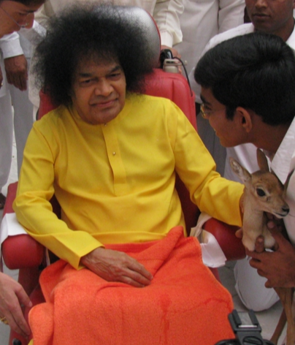
Baba to Ayodhya
Baba proceeded to ayodhya with a small group od devotees. He pointed out to them the various places associated with Ramayana and the spots sanctified by divine events.
He said that bakti was still very deeply implanted in the hearts of the people in the area
Baba gave wonder full lesson that “people worship the lord as existing in Ayodhya or Dwaraka”.and nowwhere else; That is wrong; He is everywhere.

Slide 10
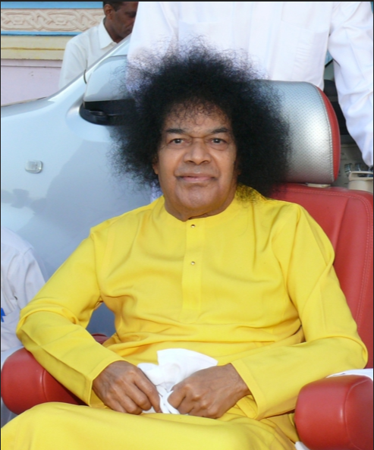
Baba blessed the devotees on the bank of Sarayu. River and took them to the temple of hanuman
Temple was given to Hanuman by Lord rama himself. Baba distributed Prasad to the devotees
Adding to the process he said of Sai Rama to that of Sakethrama!. From Ayodhya Baba reached to Sarnath the same night by car on the 21st April, Baba and his party visited the ancient temple of viswanatha at Benaras.

Slide 11
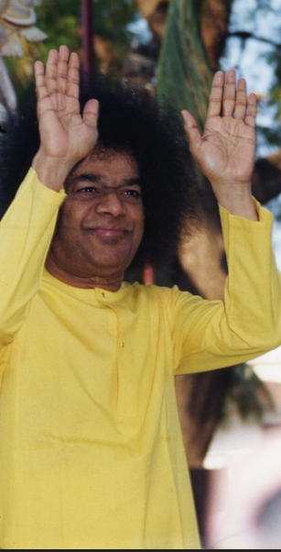
About Viswanatha of Benaras
The temple immortalised in history and the legend , in the song and poerty , by epic puranas, by bards and saint, The great shrine of the shrine of the lord of the universe. The lingam in this temple has been bathed reverentially of millions of pilgrims for thousand of years with the scared waters of the ganges; Benares itself is considered as holy land, Every inch of it; and death there id supposed to lead to the end of all misery of birth and death.
Baba watched the ceremonical pouring of ganges water on the lingam, and recfitation of traditional mantras.Then, as though impelled by sudden decision, He moved forward and materialising the kailasa vibhuti in hid plam,He applied it in three broad lines to about three quarters of the arounded image, Making it shine with peculiar splendour.

Slide 12
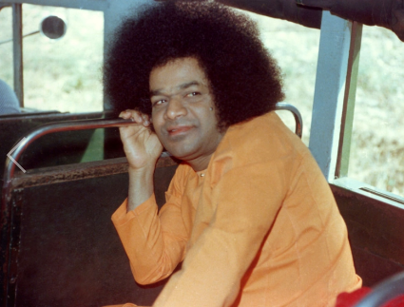
Swami Journey on 3rd April to 7th June
On baba was in allahabad,Blessing the holy Triveni Sangam by his presence and showering with his own hands th scared water of the confluence on thwe pilgrims. He also visisted the saraswathi koopa, The hanuman temple and the orginal Akshya vata, mentioned even by Hiuen Yamuna. Baba returned to puttaparthi on After only a week’s baba stay at puttaparthi, Baba left for the Niligiris. Baba said in public meeting at Ootacamund“Here the people are full of bhakti and the bhakti has endowed them with vinayam and sraddha”
3rd April
8th April.

Slide 13
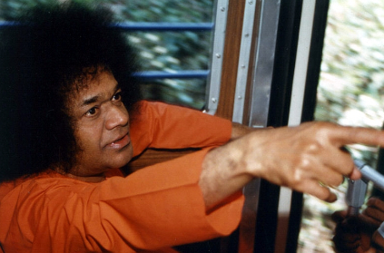
Swami Journey on 7th June to 11th July
and sent them to train to Delhi, Where He promised to bless them personally, Since He proposed to fly to captial, The very next day.
The train reached Delhi about six hours late and when the hungry, tired and distracted devotees arrvied at last, They found baba shedding cool comfort and consolation and strenght by his smile and his montherly attention.
The next day, at Hardwar ,The governor of Uttar pradesh, Dr. B.Ramakrishna Rao, joined baba, for he too had planned a visit to Badrinath.
On 11th june,Baba and his Excellency attended the evening arathi to gangamata at the Brahmakund; The vast assemblage of pilgrims got the darsan of baba at thar holy spot He materialised and he sprinkled the sacred waters of the ganges on those around Him.
7th day of June

Slide 14
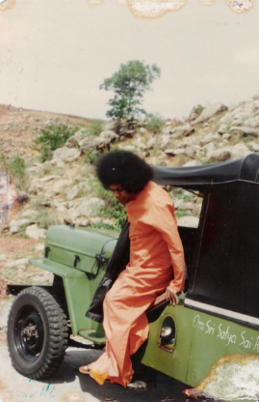
Swami Journey on 11th June to 13th june
The line of cars, jeeps and buses coiled round the meandering road and reached Devaprayag, The confluence of the Bhagrinathi and the Alakanada at about to noon. One of the purpose of the tour that baba had planned was to instill in the minds of his devotees and through them all, Faith in directed everyone to have a dip in the sacred water, before procceding to srinagar, the ancient capita; of the Garhwal Rajas. The srinagar who knew of the arrival of baba in their midst gathered in thousand wellcome Him at night
On 13th the Vehicals moved towards joshimath,where the motor road end and from where the party had walk 18 milles to badrinath.That day too Baba stopped at Nandaaprayag, the famed Kunvasram, and dicrected the devotees to bathe at the confluence of the Alakananda with Nanakini.

Slide 15
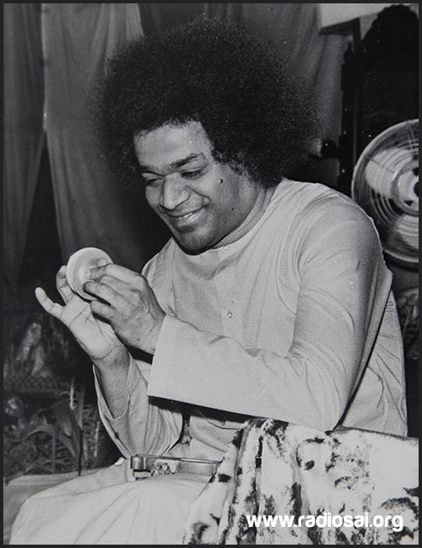
Swami Journey on 14th June to 17th june
On 14th june early in the moring the mulrs and horses were loaded with luggage, the dandis for the aged were booked, and the party started off in high spirits behind baba who led them along that sacred road. 18 miles.
On 15th and 16th days of june were rather quiet days, When Baba allowed the devotees to perform in the Badrinath temple the pooja they preferred, Himself busy with interviews to the many officers,civil and military, and the members of the temple Committee who had heard of his divinit and come to have his darsan
On 17th june the day selected by baba for re-infusing spritual efficacy the rundown battery.During the moring abhishekam at the shrine, four amred Lord Narayana idol , with Sankha,chakra,Gada,padma, an idol of supreme craftsmanship, Perphaps sublimating form , The narayana tejas or shakti before him.The baba directed Bhajan to be done and while the praise of narayana was being sung, Hen rose from floor saying”Now we shall consecrate this lingam again”, He showed the lingam to everyone

Slide 16

HEARTFULL DISCOURES BY SWAMI

Slide 17
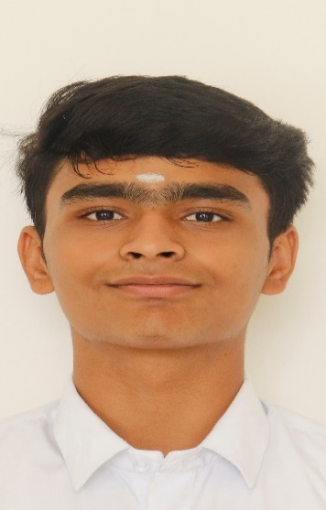
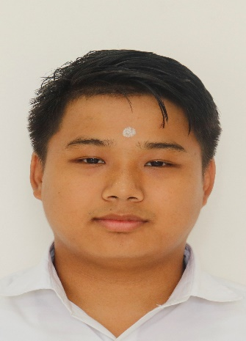
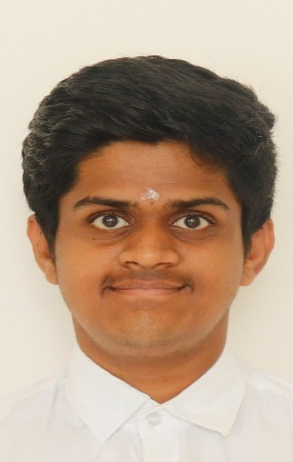
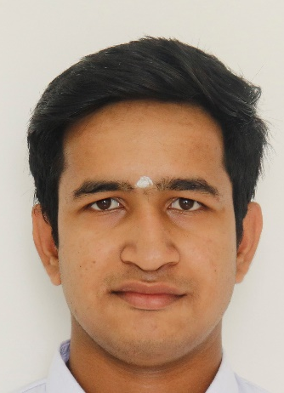
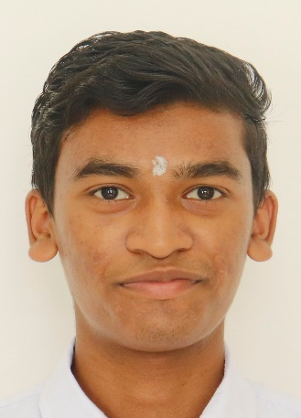
CHAPTER-15 GROUP MEMBER’S
S.Jayaraman
Alokit Tamang
1st BSc [H]
1st BBA
Reg no : 234216
Reg no : 234505
D.Abhiram
1st BSc [H]
Reg no : 234210
Shivam Deshmukh
P.Rajesh
1st BBA
1st BBA
Reg no : 234537
Reg no : 234532

Slide 18
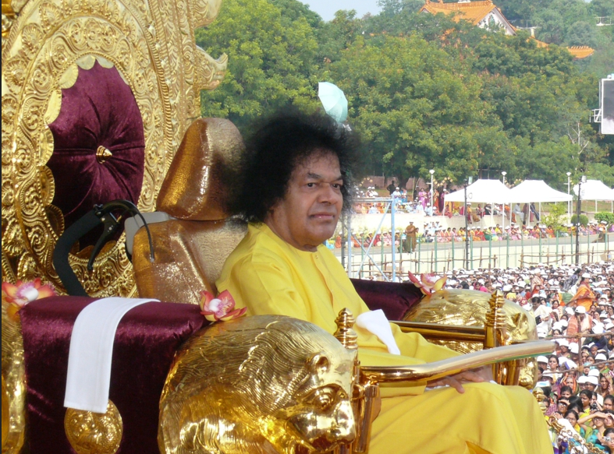
THANK YOU
JAI SAI RAM

